Slide 1



US MED-EQUIP (USME)
Technical & Commercial
Proposal
To build Custom Pricing & Discount Authorization & Approval Framework on Sales Cloud Platform
Prepared for: USME Executive Leadership
Prepared by: Durvah
Version: 1.0 | July 23, 2026

Slide 2





AGENDA
Contents
01
02
03
04
Scope
Project Timelines
Commercials
Annexure
What we will build on Sales Cloud
Phased delivery across a 20-week program
Effort, rates and commercial terms
High-level Architecture, solution Approach, business flow & Data Model
Durvah | USME Pricing & Discount Authorization Proposal
2

Slide 3





01 · SCOPE
What We Will Build on Sales Cloud
A single, system-enforced framework so every discount is evaluated, routed, and audited the same way — no exceptions handled off-platform.
Discount Data Model & Authority Matrix
Salesforce data model, automation, and UI to support Price Books, discount request & reason codes, and the multi-dimension Authority Matrix.
Tiered Approval Routing
Automated, most-restrictive-factor-wins routing across tiers, a Deal Desk queue, SLA handling, and margin-floor enforcement with a hard Finance gate.
Controls, Expiration & Audit
Discount expiration and re-approval logic, plus a full audit/override log capturing who approved what, why, and until when.
Strategic Value Score
An informational 0–20 field set surfaced to approvers for context — explicitly non-gating, per the Strategic Value Score Guide.
Reporting & Governance Dashboards
Reporting & dashboards for the Pricing Council KPIs defined in the Commercial Deal Framework (auto-approval rate, cycle time, margin realization, leakage).
Durvah | USME Pricing & Discount Authorization Proposal
3

Slide 4

02 · PROJECT TIMELINES
Delivery Roadmap — 20-Week Program
W1–W3
W7–W11
W15–W17
Bundle Discounting Engine
Multi-Tier Approval & SLA Escalation
KPI Reports & Dashboards
W4–W6
W12–W14
W18–W20
Strategic Value Score & Reason Codes
Safeguards & Validation Rules
Data Cleanup & Core Schema
Overall timeframe: 2–3 months (20 working weeks) from build kickoff to production-ready governance reporting.
Durvah | USME Pricing & Discount Authorization Proposal
4

Slide 5

02 · PROJECT TIMELINES
Project Governance
Working with the USME SPOC to deliver the project on time, on scope, and with full visibility into risk.
WEEKLY
AD-HOC
Project Progress Review
Working Session
Participants: Durvah + USME SPOC (Business & IT)
Participants: Durvah + USME SPOC
Overall status against plan
Scheduling of meetings / planning
Issues, delays & risk mitigation
Discussion as and when inputs, clarifications, or confirmations are required
Fast-turnaround decisions to keep the build unblocked
Owner: Durvah
Owner: Durvah
Durvah | USME Pricing & Discount Authorization Proposal
7

Slide 6
03 · COMMERCIALS
Implementation Commercials
Implementation Services | Rate | Amount
Grand Total |  | [ CURRENCY TOTAL ]
Commercial Notes
Any requirement outside the agreed scope will be treated as a Change Request (CR), estimated separately, and charged at the agreed person-day rate.
Costing is inclusive of professional fees and standard delivery expenses for remote delivery.
If consultants are required to travel to a USME site, travel, local transport, accommodation and other incidental expenses will be charged to USME at actuals.
This commercial proposal is valid for 30 days from the date of issue unless otherwise agreed in writing.
Durvah | USME Pricing & Discount Authorization Proposal
8

Slide 7
04 · ANNEXURE A
High Level Architecture
Salesforce – Sales Cloud Platform
Out-of-Box / Native Platform
Opportunity
Custom Build
Native Approval Work flow Engine
Bundle Discounting
Discount Request
Deal Desk Queue
Authority Matrix
Price Books
Role Hierarchy
Strategic Value Score
Custom Masters
Tier Evaluation Flow
Quote / Quote Line
Reports & Dashboards
Contracts
External System
GOUSME (ERP)
Masters & Customer Data
Service NOW

Slide 8
04 · ANNEXURE B
Solution Approach — Out-of-the-Box vs. Custom Build
Capability | Out-of-the-Box (Sales Cloud) | Custom Build Required
Price Books | Standard Price Book & Entry objects; multiple price books per product. | Rental-term & product-family fields; CPQ Price Rules if licensed.
Discount capture | Quote Line Item standard Discount % field. | Discount Request object for Reason Code, concessions, expiration, justification.
Margin calculation | None native on standard Quotes. | Formula/Flow for Gross Margin %/$; Margin Floor Custom Metadata Type.
Authority Matrix | None native. | Custom Metadata Type + Record-Triggered Flow evaluating 5 dimensions.
Approval routing | Native Approval Process engine (multi-step). | Entry criteria on calculated tier; Deal Desk queue for Tier 3–4.
Strategic Value Score | None native. | Custom build of strategic value score feature
Audit / override log | Field history (limited retention). | Custom Approval/Override Log object, independent of history limits.
Discount expiration & re-approval | None native. | Expiration Date field + scheduled Flow (batch or Flow with schedule trigger) that flags/deactivates expired discounts and forces re-approval at renewal.
Deal Desk queue & SLA | Queues (native); Case/Task assignment. | SLA timers (Flow + time-based actions) per tier per the SLA table in the deck; Deal Desk-specific list views/queue.
Reporting & Dashboards | Native Reports & Dashboards. | Custom report types joining Quote, Discount Request, Approval Log to surface auto-approval rate, cycle time, discount depth, leakage, and exception rate.
Full mapping (12 capabilities) is provided in the accompanying Technical Design Document.
Durvah | USME Pricing & Discount Authorization Proposal
9

Slide 9
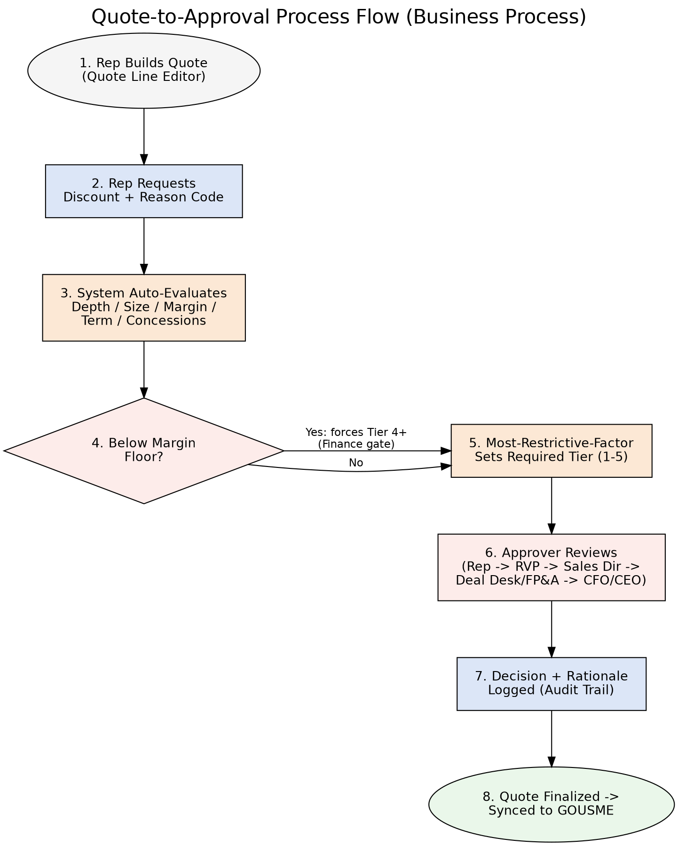
04 · ANNEXURE C
Business Flow — Quote to Approval
Durvah | USME Pricing & Discount Authorization Proposal
10

Slide 10
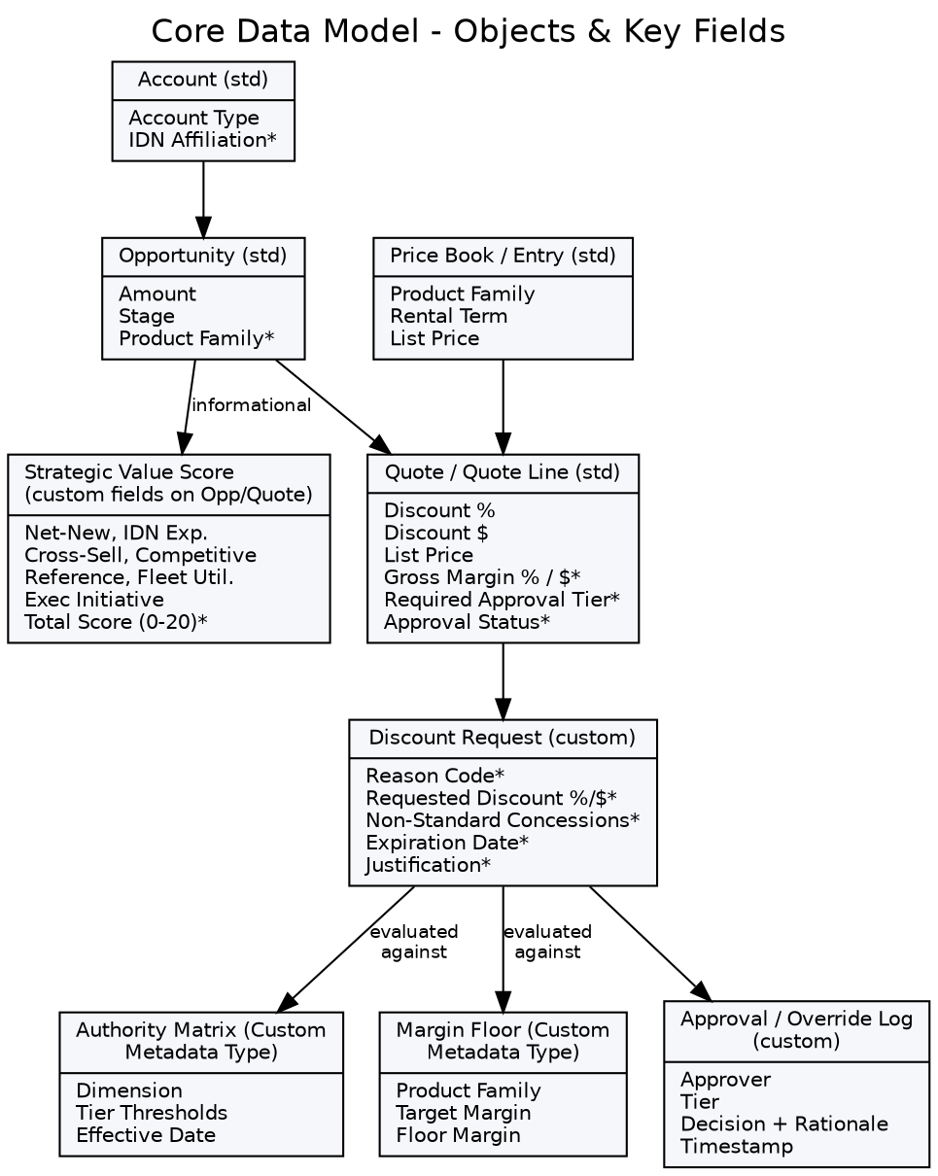
04 · ANNEXURE D
Data Model

Slide 11

Thank You
For your valuable time and attention !!
www.durvah.com

